Slide 1
Introduction (PART 1)

Slide 2
What is a Neural Network?
Neural network is a general name including both
Biological neural networks (e.g. human nervous system)
Artificial neural networks
Our main topic is artificial neural networks (ANNs)
We will sometimes say “neural network” to refer to an ANN

Slide 3
What is a Neural Network?
Biological neural networks (such as human brain) compute in a different way from today’s computers
The brain is a highly complex, nonlinear, and parallel computer
It can organize its own structure (connected neurons) to perform certain computations much faster than current computers

Slide 4
What is a Neural Network?
(Artificial) neural network is a machine that is designed to model the way in which the brain performs a particular task or function of interest; usually
implemented by using electronic components
or simulated in software on a computer
Our interest will mostly be on a group of ANNs which do useful computations after a learning process
As the name implies, it is a network of smaller computing units called neurons

Slide 5
What is a Neural Network?
(Definition by Alexander & Morton 1990)
A neural network is a massively parallel distributed processor made up of simple processing units, which has a natural propensity for storing experimental knowledge and making it available for use. It resembles the brain in two respects:
Knowledge is acquired by the network from its environment through a learning process
Interneuron connection strengths, known as synaptic weights, are used to store the acquired knowledge.

Slide 6
What is a Neural Network?
The procedure used to perform the learning process is called a learning algorithm
The main idea here is to modify the synaptic weights of the network in some way so as to achieve a desired objective

Slide 7
Benefits of ANNs
Nonlinearity: Neurons can be linear or nonlinear. Nonlinearity also comes from the networking. This is an important property particularly when we are working on nonlinear problems.
Input-Output mapping: An ANN learns how to map inputs to outputs from examples. This is similar to nonparametric statistical inference (a branch of statistics) and tabula rasa learning (biology)
Adaptivity: An ANN trained to work for a specific case can easily be retrained to deal with minor changes in conditions. In fact, it can be designed to do this in a changing environment. But, there is often a critical line between an adaptive system and a robust one.

Slide 8
Benefits of ANNs
Evidential Response: An ANN can be designed not only to give us a decision but also to give us how confident it is in that decision.
Contextual Information: Knowledge is represented by the structure. Every neuron is potentially affected by all others in the network. Therefore, contextual information is dealt with naturally.
Fault Tolerance: In hardware form, ANNs are fault tolerant in the sense that, if a neuron fails the general performance is only slightly degraded.

Slide 9
Benefits of ANNs
VLSI Implementability: An ANN is well suited to be implemented using very-large-scale-integrated (VLSI) technology.
Uniformity of Analysis and Design: Same notation (neurons being the main unit, etc.) is used in all domains involving the application of neural networks.
Neurobiological Analogy: ANNs are motivated by analogy with the brain, which is a living proof that fault tolerant parallel processing is not only physically possible but also fast and powerful.

Slide 10
Human Brain
May be viewed as a three-stage system as below
Brain (neural net); Receptors convert stimuli into electrical impulses; Effectors convert electrical impulses into responses (system outputs)
Left to right arrows: forward transmission: Right to left: feedback
Neurons are five to six orders of magnitude slower than silicon logic gates
Neural events happen in 10⁻³ s range, whereas silicon gate events happen in 10⁻⁹ s
Yet, brain makes up for this by having extremely many neurons and complex interconnections between them
There are approximately 10 billion neurons in the human cortex and 60 trillion connections (synapses)
Also, brain is energy efficient (10⁻¹⁶ joules per operation per second)
Computers today have about 10⁻⁶ joules per operation per second)

Slide 11
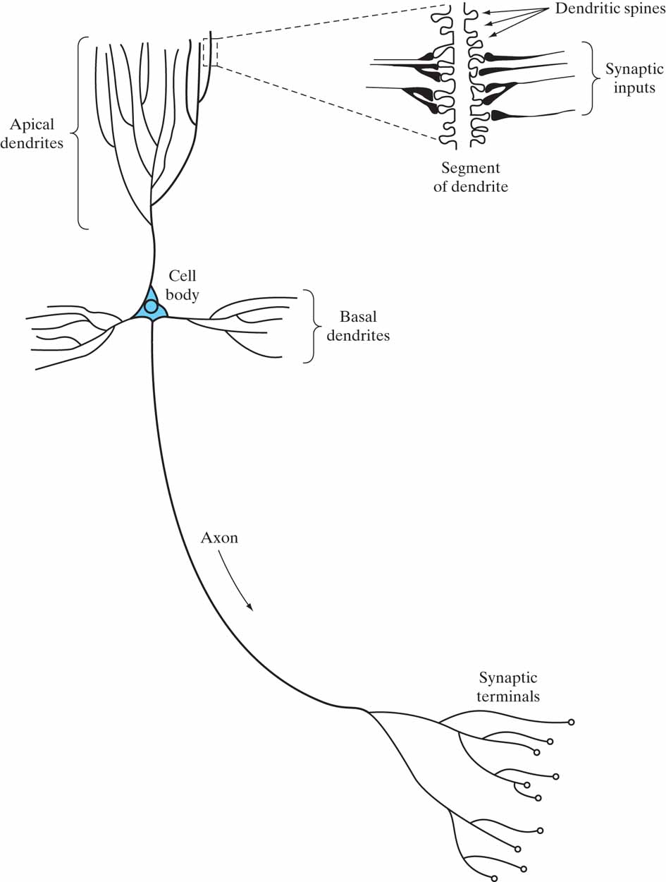
The Pyramidal Cell

Slide 12
http://youtu.be/gcK_5x2KsLA

Slide 13
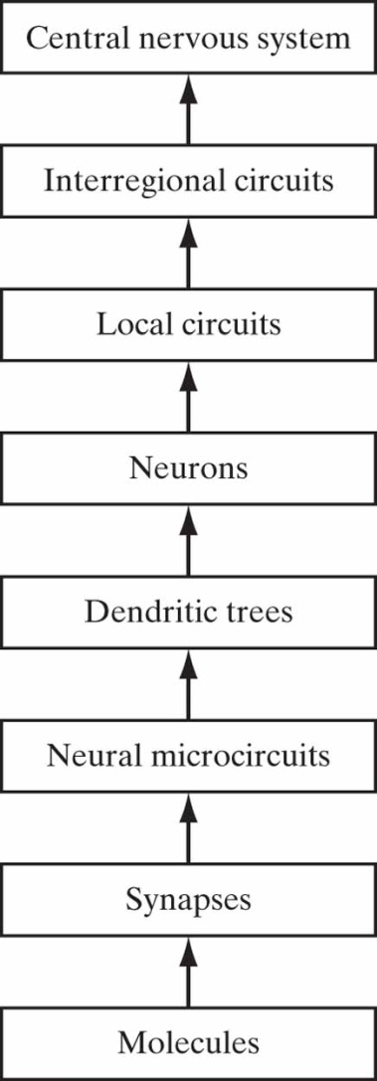
Human Brain
There are both small-scale and large-scale anatomical organizations
Different functions take place at lower and higher levels

Slide 14
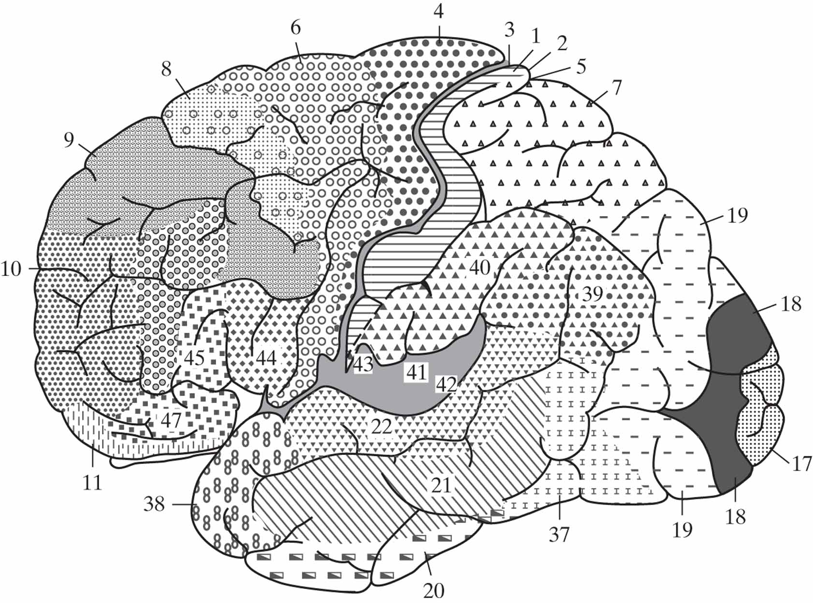
Figure 4 Cytoarchitectural map of the cerebral cortex. The different areas are identified by the thickness of their layers and types of cells within them. Some of the key sensory areas are as follows: Motor cortex: motor strip, area 4; premotor area, area 6; frontal eye fields, area 8. Somatosensory cortex: areas 3, 1, and 2. Visual cortex: areas 17, 18, and 19. Auditory cortex: areas 41 and 42. (From A. Brodal, 1981; with permission of Oxford University Press.)

Slide 15
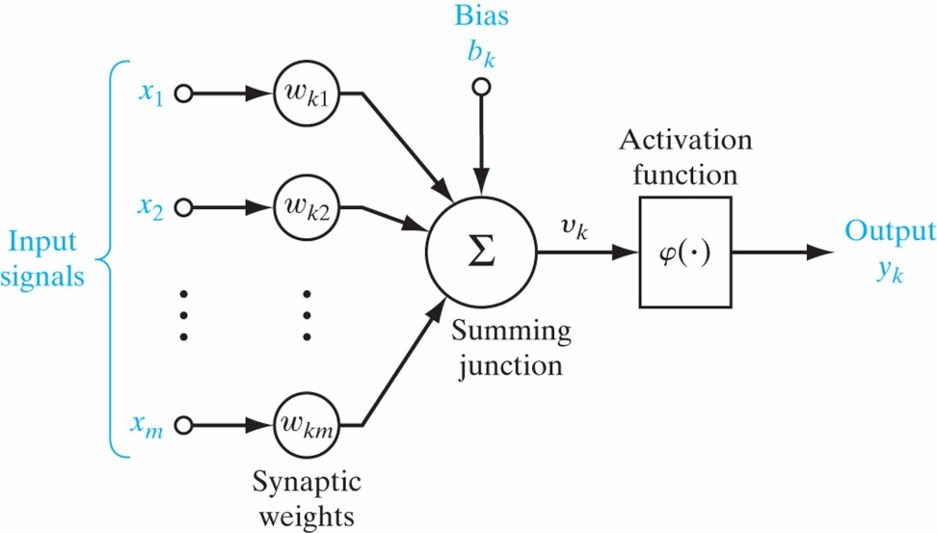
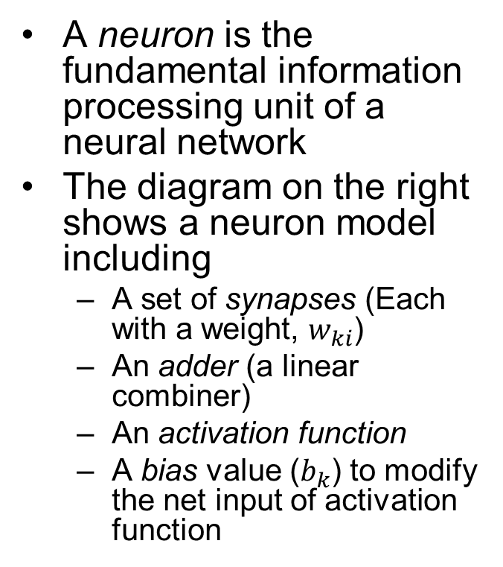
Artificial Neuron Models
A neuron is the fundamental information processing unit of a neural network
The diagram on the right shows a neuron model including
A set of synapses (Each with a weight, $w_{ki}$)
An adder (a linear combiner)
An activationfunction
A bias value ($b_{k}$) to modify the net input of activation function

Slide 16
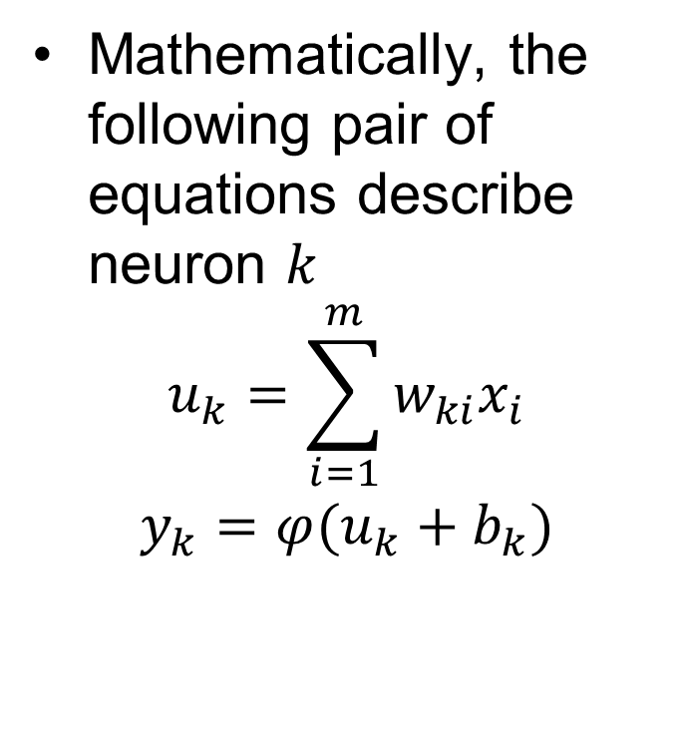
Artificial Neuron Models
Mathematically, the following pair of equations describe neuron $k$
$$u_{k}=\sum_{i=1}^{m}{w_{ki}x_{i}}$$
$$y_{k}=φ(u_{k}+b_{k})$$

Slide 17
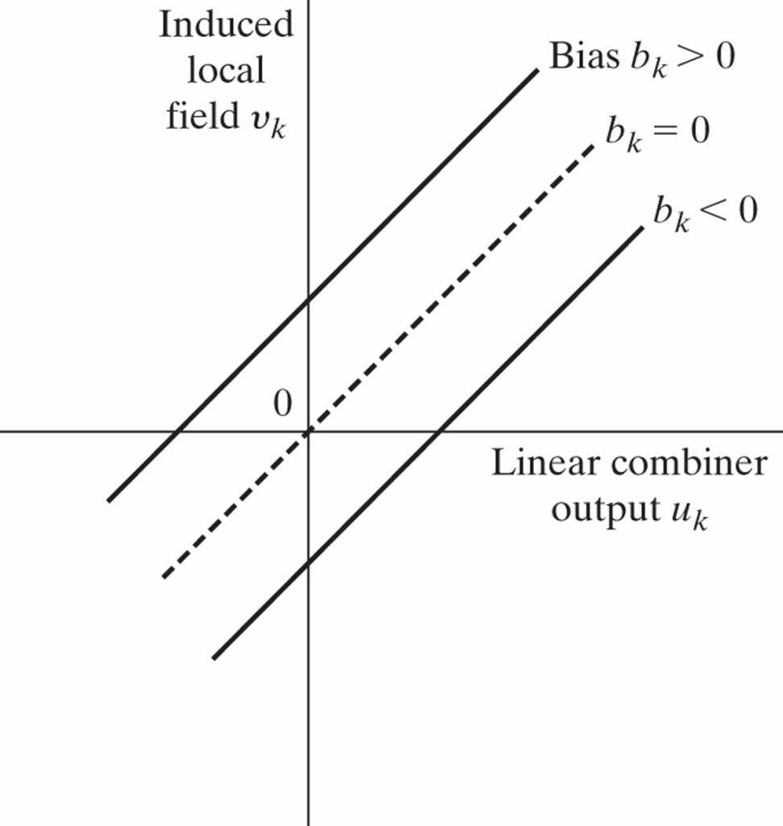
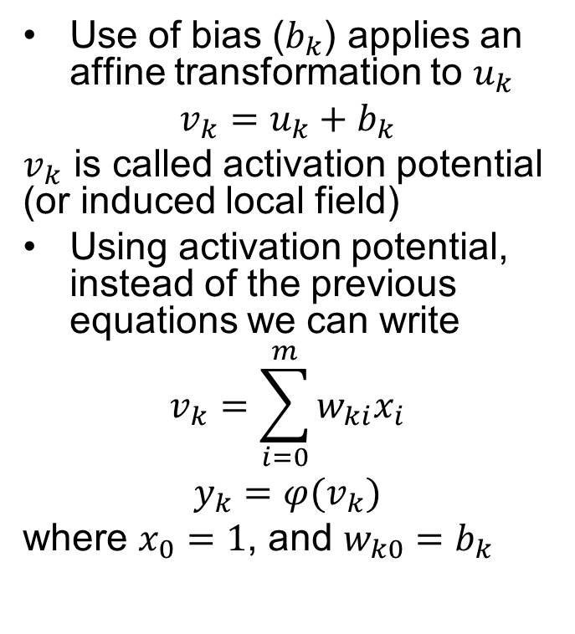
Artificial Neuron Model
Use of bias ($b_{k}$) applies an affine transformation to $u_{k}$
$$v_{k}=u_{k}+b_{k}$$
$v_{k}$ is called activation potential (or induced local field)
Using activation potential, instead of the previous equations we can write
$$v_{k}=\sum_{i=0}^{m}{w_{ki}x_{i}}$$
$$y_{k}=φ(v_{k})$$
where $x_{0}=1$, and $w_{k0}=b_{k}$

Slide 18
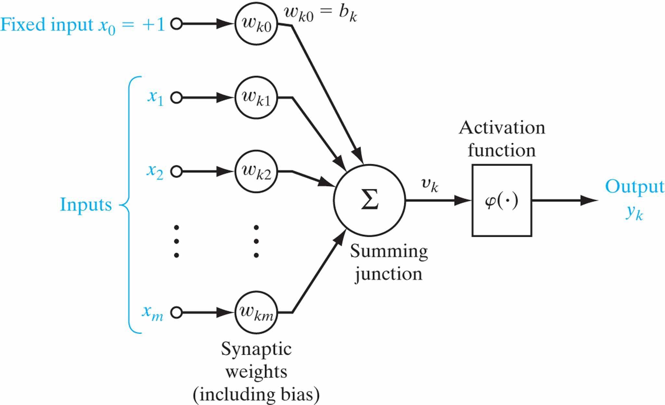
Figure 7 Another nonlinear model of a neuron; w_{k0} accounts for the bias b_{k}.

